Slide 1
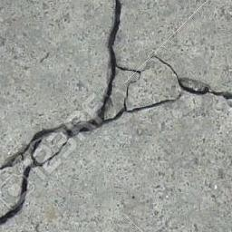
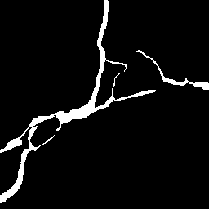
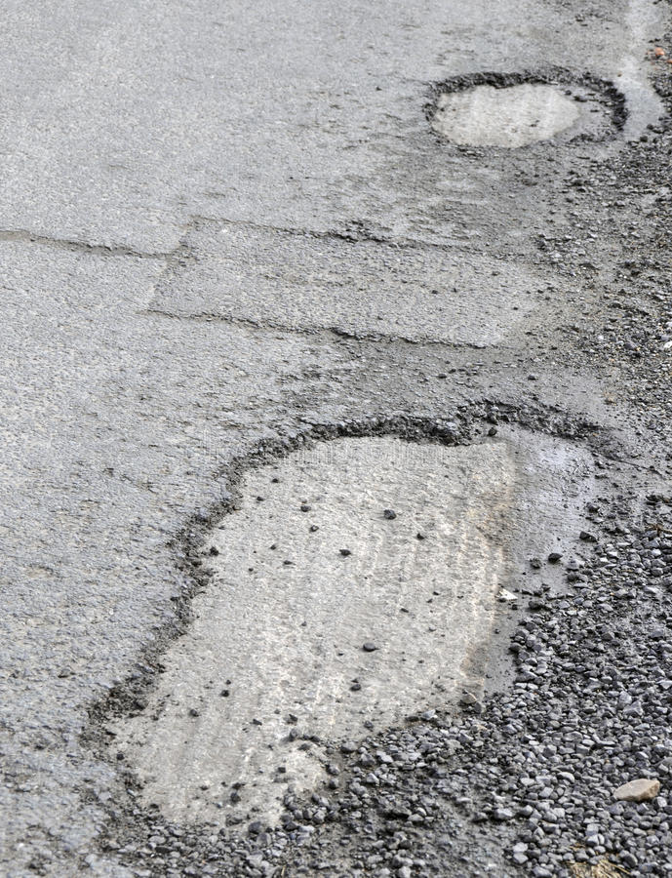
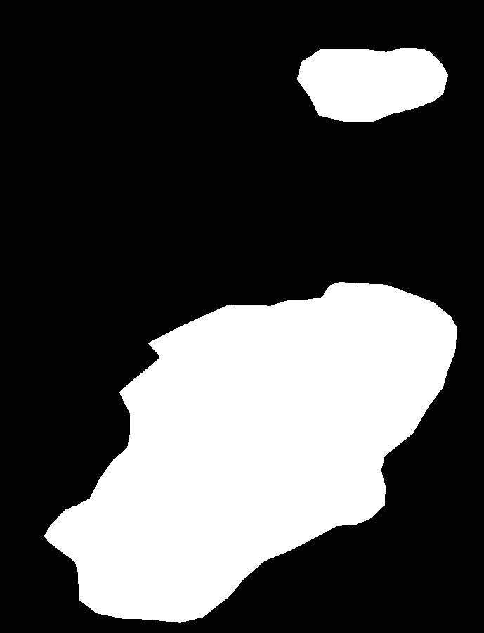
Traditional method
quantity
PCI
severity
Calculate PCI
Classify
…
Our method

Slide 2
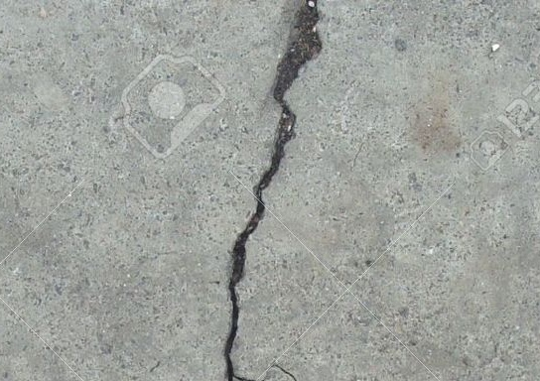
Segmentation
Calculate PCI
(a)
Classification or
Object Targeting
Severity
Estimation
Crack, Pothole, Rutting…
PCI
(b)
Image Regression
(c)
Manual inspections according to ASTM D6433

Slide 3
A
Manual inspections according to ASTM D6433
B
Image Regression
PCI
Calculate PCI
Segmentation
Crack, Pothole, Rutting…
C
Classification or
Object Targeting
Severity
Estimation

Slide 4
(a)
Manual inspections according to ASTM D6433
(c)
Image Regression
PCI
Calculate PCI
(b)
Classification/
Object Targeting/Segmentation
Severity
Estimation

Slide 5
Conv2d(3*3)
Conv2d(1*1)
Conv2d(1*1)
Conv2d(1*1)
Conv2d(1*1)
Conv2d(1*1)
Conv2d(1*1)
Conv2d(1*1)
Conv2d(1*1)
Conv2d(1*1)
Conv2d(1*1)
BatchNorm2d
BatchNorm2d
BatchNorm2d
BatchNorm2d
BatchNorm2d
BatchNorm2d
BatchNorm2d
BatchNorm2d
BatchNorm2d
BatchNorm2d
BatchNorm2d
SiLU
SiLU
SiLU
SiLU
SiLU
SiLU
SiLU
SiLU
SiLU
SiLU
SiLU
Conv2d(3*3)
Conv2d(3*3)
Conv2d(5*5)
Conv2d(5*5)
Conv2d(5*5)
Conv2d(3*3)
Conv2d(3*3)
Conv2d(5*5)
Conv2d(5*5)
Conv2d(3*3)
Conv2d(3*3)
BatchNorm2d
BatchNorm2d
BatchNorm2d
BatchNorm2d
BatchNorm2d
BatchNorm2d
BatchNorm2d
BatchNorm2d
BatchNorm2d
BatchNorm2d
BatchNorm2d
SiLU
SiLU
SiLU
SiLU
SiLU
SiLU
SiLU
SiLU
SiLU
SiLU
SiLU
AdaptiveAvgPool2D
AdaptiveAvgPool2D
AdaptiveAvgPool2D
AdaptiveAvgPool2D
AdaptiveAvgPool2D
AdaptiveAvgPool2D
AdaptiveAvgPool2D
AdaptiveAvgPool2D
AdaptiveAvgPool2D
AdaptiveAvgPool2D
AdaptiveAvgPool2D
Conv2d(1*1)
Conv2d(1*1)
Conv2d(1*1)
Conv2d(1*1)
Conv2d(1*1)
Conv2d(1*1)
Conv2d(1*1)
Conv2d(1*1)
Conv2d(1*1)
Conv2d(1*1)
Conv2d(1*1)
Conv2d(1*1)
Conv2d(1*1)
Conv2d(1*1)
Conv2d(1*1)
Conv2d(1*1)
Conv2d(1*1)
Conv2d(1*1)
Conv2d(1*1)
Conv2d(1*1)
Conv2d(1*1)
Conv2d(1*1)
SiLU
SiLU
SiLU
SiLU
SiLU
SiLU
SiLU
SiLU
SiLU
SiLU
SiLU
sigmoid
sigmoid
sigmoid
sigmoid
sigmoid
sigmoid
sigmoid
sigmoid
sigmoid
sigmoid
sigmoid
Conv2d(1*1)
Conv2d(1*1)
Conv2d(1*1)
Conv2d(1*1)
Conv2d(1*1)
Conv2d(1*1)
Conv2d(1*1)
Conv2d(1*1)
Conv2d(1*1)
Conv2d(1*1)
Conv2d(1*1)
BatchNorm2d
BatchNorm2d
BatchNorm2d
BatchNorm2d
BatchNorm2d
BatchNorm2d
BatchNorm2d
BatchNorm2d
BatchNorm2d
BatchNorm2d
BatchNorm2d
StochasticDepth(p=0)
StochasticDepth(p=0.0125)
StochasticDepth(p=0.025)
StochasticDepth(p=0.0625)
StochasticDepth(p=0.075)
StochasticDepth(p=0.0875)
StochasticDepth(p=0.1)
StochasticDepth(p=0.1125)
StochasticDepth(p=0.125)
StochasticDepth(p=0.0375)
StochasticDepth(p=0.05)
Conv2d(1*1)
Conv2d(1*1)
Conv2d(1*1)
Conv2d(1*1)
Conv2d(1*1)
Conv2d(1*1)
BatchNorm2d
BatchNorm2d
BatchNorm2d
BatchNorm2d
BatchNorm2d
BatchNorm2d
SiLU
SiLU
SiLU
SiLU
SiLU
SiLU
Conv2d(5*5)
Conv2d(5*5)
Conv2d(5*5)
Conv2d(3*3)
AdaptiveAvgPool2D
Conv2d(5*5)
BatchNorm2d
BatchNorm2d
BatchNorm2d
BatchNorm2d
BatchNorm2d
SiLU
SiLU
SiLU
SiLU
Drop out(p=0.2)
SiLU
AdaptiveAvgPool2D
AdaptiveAvgPool2D
AdaptiveAvgPool2D
AdaptiveAvgPool2D
AdaptiveAvgPool2D
Conv2d(1*1)
Linear (features, 1)
Conv2d(1*1)
Conv2d(1*1)
Conv2d(1*1)
Conv2d(1*1)
Conv2d(1*1)
Conv2d(1*1)
Conv2d(1*1)
Conv2d(1*1)
Conv2d(1*1)
SiLU
SiLU
SiLU
SiLU
sigmoid
SiLU
sigmoid
sigmoid
sigmoid
sigmoid
sigmoid
Conv2d(1*1)
Conv2d(1*1)
Conv2d(1*1)
Conv2d(1*1)
Conv2d(1*1)
BatchNorm2d
BatchNorm2d
BatchNorm2d
BatchNorm2d
BatchNorm2d
StochasticDepth(p=0.15)
StochasticDepth(p=0.1625)
StochasticDepth(p=0.175)
StochasticDepth(p=0.1875)
StochasticDepth(p=0.1375)

Slide 6
Conv2d(3*3)
Conv2d(1*1)
Conv2d(1*1)
Conv2d(1*1)
Conv2d(1*1)
Conv2d(1*1)
Conv2d(1*1)
Conv2d(1*1)
Conv2d(1*1)
Conv2d(1*1)
Conv2d(1*1)
BatchNorm2d
BatchNorm2d
BatchNorm2d
BatchNorm2d
BatchNorm2d
BatchNorm2d
BatchNorm2d
BatchNorm2d
BatchNorm2d
BatchNorm2d
BatchNorm2d
SiLU
SiLU
SiLU
SiLU
SiLU
SiLU
SiLU
SiLU
SiLU
SiLU
SiLU
Conv2d(3*3)
Conv2d(3*3)
Conv2d(5*5)
Conv2d(5*5)
Conv2d(5*5)
Conv2d(3*3)
Conv2d(3*3)
Conv2d(5*5)
Conv2d(5*5)
Conv2d(3*3)
Conv2d(3*3)
BatchNorm2d
BatchNorm2d
BatchNorm2d
BatchNorm2d
BatchNorm2d
BatchNorm2d
BatchNorm2d
BatchNorm2d
BatchNorm2d
BatchNorm2d
BatchNorm2d
SiLU
SiLU
SiLU
SiLU
SiLU
SiLU
SiLU
SiLU
SiLU
SiLU
SiLU
AdaptiveAvgPool2D
AdaptiveAvgPool2D
AdaptiveAvgPool2D
AdaptiveAvgPool2D
AdaptiveAvgPool2D
AdaptiveAvgPool2D
AdaptiveAvgPool2D
AdaptiveAvgPool2D
AdaptiveAvgPool2D
AdaptiveAvgPool2D
AdaptiveAvgPool2D
Conv2d(1*1)
Conv2d(1*1)
Conv2d(1*1)
Conv2d(1*1)
Conv2d(1*1)
Conv2d(1*1)
Conv2d(1*1)
Conv2d(1*1)
Conv2d(1*1)
Conv2d(1*1)
Conv2d(1*1)
Conv2d(1*1)
Conv2d(1*1)
Conv2d(1*1)
Conv2d(1*1)
Conv2d(1*1)
Conv2d(1*1)
Conv2d(1*1)
Conv2d(1*1)
Conv2d(1*1)
SiLU
Conv2d(1*1)
Conv2d(1*1)
SiLU
SiLU
SiLU
SiLU
SiLU
SiLU
SiLU
SiLU
sigmoid
SiLU
SiLU
sigmoid
sigmoid
sigmoid
sigmoid
sigmoid
sigmoid
sigmoid
sigmoid
Conv2d(1*1)
sigmoid
sigmoid
Conv2d(1*1)
Conv2d(1*1)
Conv2d(1*1)
Conv2d(1*1)
Conv2d(1*1)
Conv2d(1*1)
Conv2d(1*1)
Conv2d(1*1)
BatchNorm2d
Conv2d(1*1)
Conv2d(1*1)
BatchNorm2d
BatchNorm2d
BatchNorm2d
BatchNorm2d
BatchNorm2d
BatchNorm2d
BatchNorm2d
BatchNorm2d
StochasticDepth(p=0)
BatchNorm2d
BatchNorm2d
StochasticDepth(p=0.0125)
StochasticDepth(p=0.025)
StochasticDepth(p=0.0625)
StochasticDepth(p=0.075)
StochasticDepth(p=0.0875)
StochasticDepth(p=0.1)
StochasticDepth(p=0.1125)
StochasticDepth(p=0.125)
StochasticDepth(p=0.0375)
StochasticDepth(p=0.05)
Conv2d(1*1)
Conv2d(1*1)
Conv2d(1*1)
Conv2d(1*1)
Conv2d(1*1)
Conv2d(1*1)
BatchNorm2d
BatchNorm2d
BatchNorm2d
BatchNorm2d
BatchNorm2d
BatchNorm2d
SiLU
SiLU
SiLU
SiLU
SiLU
SiLU
Conv2d(5*5)
Conv2d(5*5)
Conv2d(5*5)
Conv2d(3*3)
AdaptiveAvgPool2D
Conv2d(5*5)
BatchNorm2d
BatchNorm2d
BatchNorm2d
BatchNorm2d
BatchNorm2d
SiLU
SiLU
SiLU
SiLU
Drop out(p=0.2)
SiLU
AdaptiveAvgPool2D
AdaptiveAvgPool2D
AdaptiveAvgPool2D
AdaptiveAvgPool2D
AdaptiveAvgPool2D
Conv2d(1*1)
Linear (features, 1)
Conv2d(1*1)
Conv2d(1*1)
Conv2d(1*1)
Conv2d(1*1)
Conv2d(1*1)
Conv2d(1*1)
Conv2d(1*1)
Conv2d(1*1)
Conv2d(1*1)
SiLU
SiLU
SiLU
SiLU
sigmoid
SiLU
sigmoid
sigmoid
sigmoid
sigmoid
sigmoid
Conv2d(1*1)
Conv2d(1*1)
Conv2d(1*1)
Conv2d(1*1)
Conv2d(1*1)
BatchNorm2d
BatchNorm2d
BatchNorm2d
BatchNorm2d
BatchNorm2d
StochasticDepth(p=0.15)
StochasticDepth(p=0.1625)
StochasticDepth(p=0.175)
StochasticDepth(p=0.1875)
StochasticDepth(p=0.1375)

Slide 7





































Stochastic Depth (p=0.0125)
Stochastic Depth (p=0.025)
Stochastic Depth (p=0.0375)
Stochastic Depth (p=0.05)
Stochastic Depth (p=0.0625)
Stochastic Depth (p=0.075)
Stochastic Depth (p=0.0875)
PCI-Block ($3×3$)
Conv2d($1×1$)
SiLU
PCI-Block ($3×3$)
BatchNorm2d
Conv2d($1×1$)
SiLU
PCI-Block ($3×3$)
BatchNorm2d
Conv2d($1×1$)
SiLU
PCI-Block ($5×5$)
BatchNorm2d
Conv2d($1×1$)
SiLU
PCI-Block ($5×5$)
BatchNorm2d
Conv2d($1×1$)
SiLU
PCI-Block ($3×3$)
BatchNorm2d
Conv2d($1×1$)
SiLU
Conv2d($3×3$)
SiLU
BatchNorm2d
BatchNorm2d
PCI-Block ($3×3$)
Conv2d($1×1$)
SiLU
PCI-Block ($3×3$)
BatchNorm2d
PCI-Block ($5×5$)
PCI-Block ($5×5$)
Conv2d($1×1$)
SiLU
SiLU
BatchNorm2d
Conv2d($1×1$)
PCI-Block ($5×5$)
BatchNorm2d
Conv2d($1×1$)
SiLU
PCI-Block ($5×5$)
PCI-Block ($5×5$)
BatchNorm2d
Conv2d($1×1$)
SiLU
SiLU
BatchNorm2d
Conv2d($1×1$)
BatchNorm2d
Conv2d($3×3$)
BatchNorm2d
SiLU
Stochastic Depth (p=0.1)
Stochastic Depth (p=0.1125)
Stochastic Depth (p=0.125)
Stochastic Depth (p=0.1375)
Stochastic Depth (p=0.15)
AdaptiveAvgPool2D
Conv2d($1×1$)
Conv2d($1×1$)
SiLU
sigmoid
Conv2d($1×1$)
AdaptiveAvgPool2D
Dropout (p=0.2)
Linear (features, 1)
PCI-Block ($5×5$)
SiLU
sigmoid
SiLU
PCI-Block ($3×3$)
SiLU
Conv2d($3×3$)
Conv2d($1×1$)
BatchNorm2d
BatchNorm2d
PCI-Block ($5×5$)
SiLU
Conv2d($1×1$)
Conv2d($1×1$)
BatchNorm2d
BatchNorm2d
BatchNorm2d
Stochastic Depth (p=0.1625)
Stochastic Depth (p=0.175)
Stochastic Depth (p=0.1875)

Slide 8





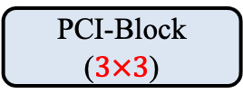





Conv2d($3×3$)
Conv2d($3×3$)
BatchNorm2d
BatchNorm2d
Conv2d($3×3$)
SiLU
SiLU
BatchNorm2d
PCI-Block ($3×3$)
SiLU
AdaptiveAvgPool2D
Conv2d($1×1$)
Conv2d($1×1$)
BatchNorm2d
Conv2d($1×1$)
Stochastic Depth (p=0.0125)
SiLU
SiLU
sigmoid
PCI-Block ($3×3$)
Conv2d($1×1$)
BatchNorm2d
Conv2d($1×1$)
BatchNorm2d
Stochastic Depth (p=0.025)
SiLU
PCI-Block ($3×3$)

Slide 9






Conv2d($3×3$)
Conv2d($3×3$)
BatchNorm2d
BatchNorm2d
SiLU
SiLU
PCI-Block
Conv2d($3×3$)
PCI-Block
BatchNorm2d
SiLU
AdaptiveAvgPool2D
Conv2d($1×1$)
Conv2d($1×1$)
SiLU
sigmoid
Conv2d($1×1$)
StochasticDepth(p=0)
BatchNorm2d

Slide 10
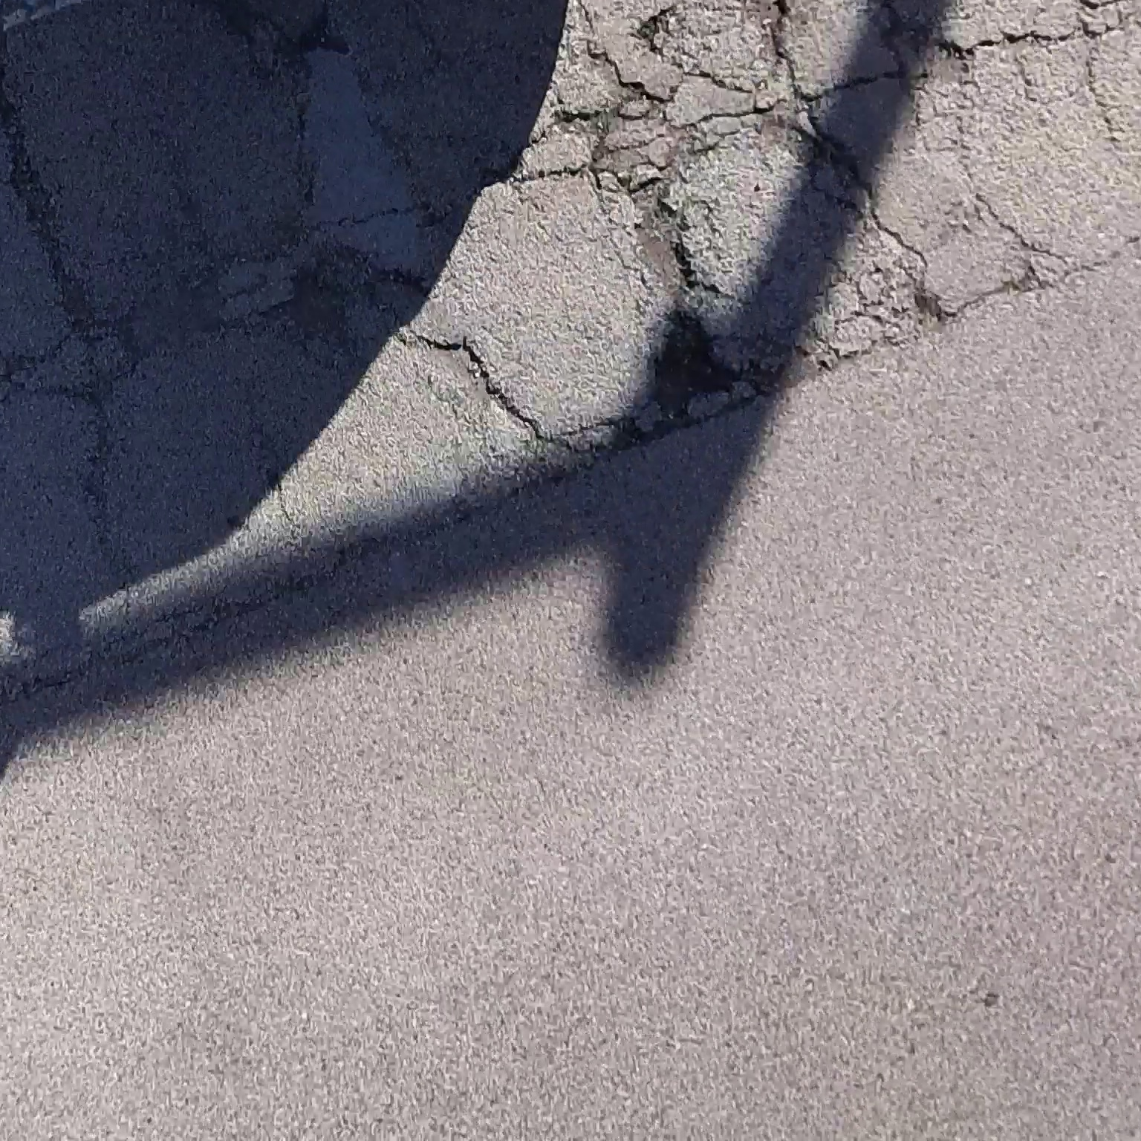
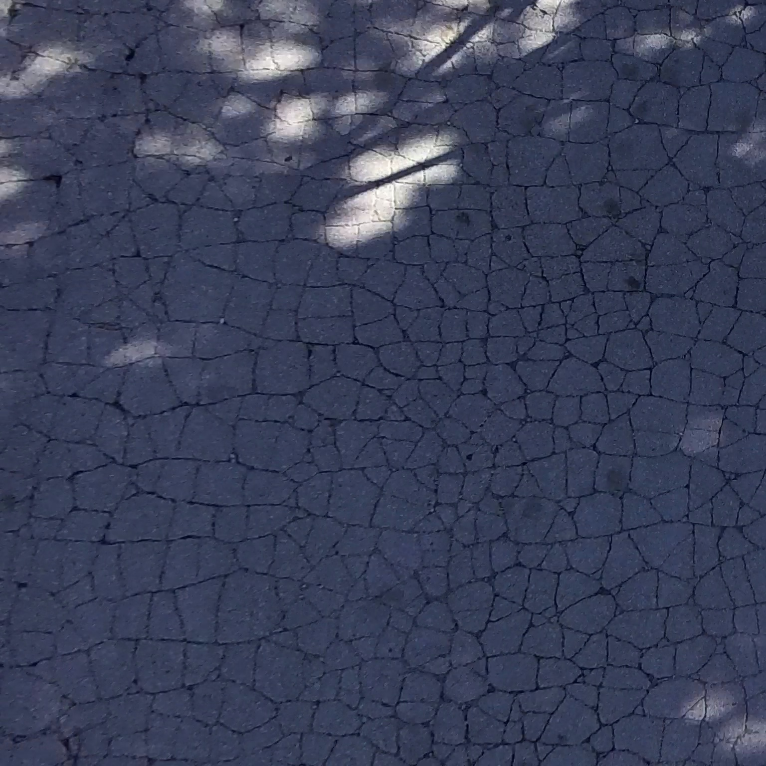
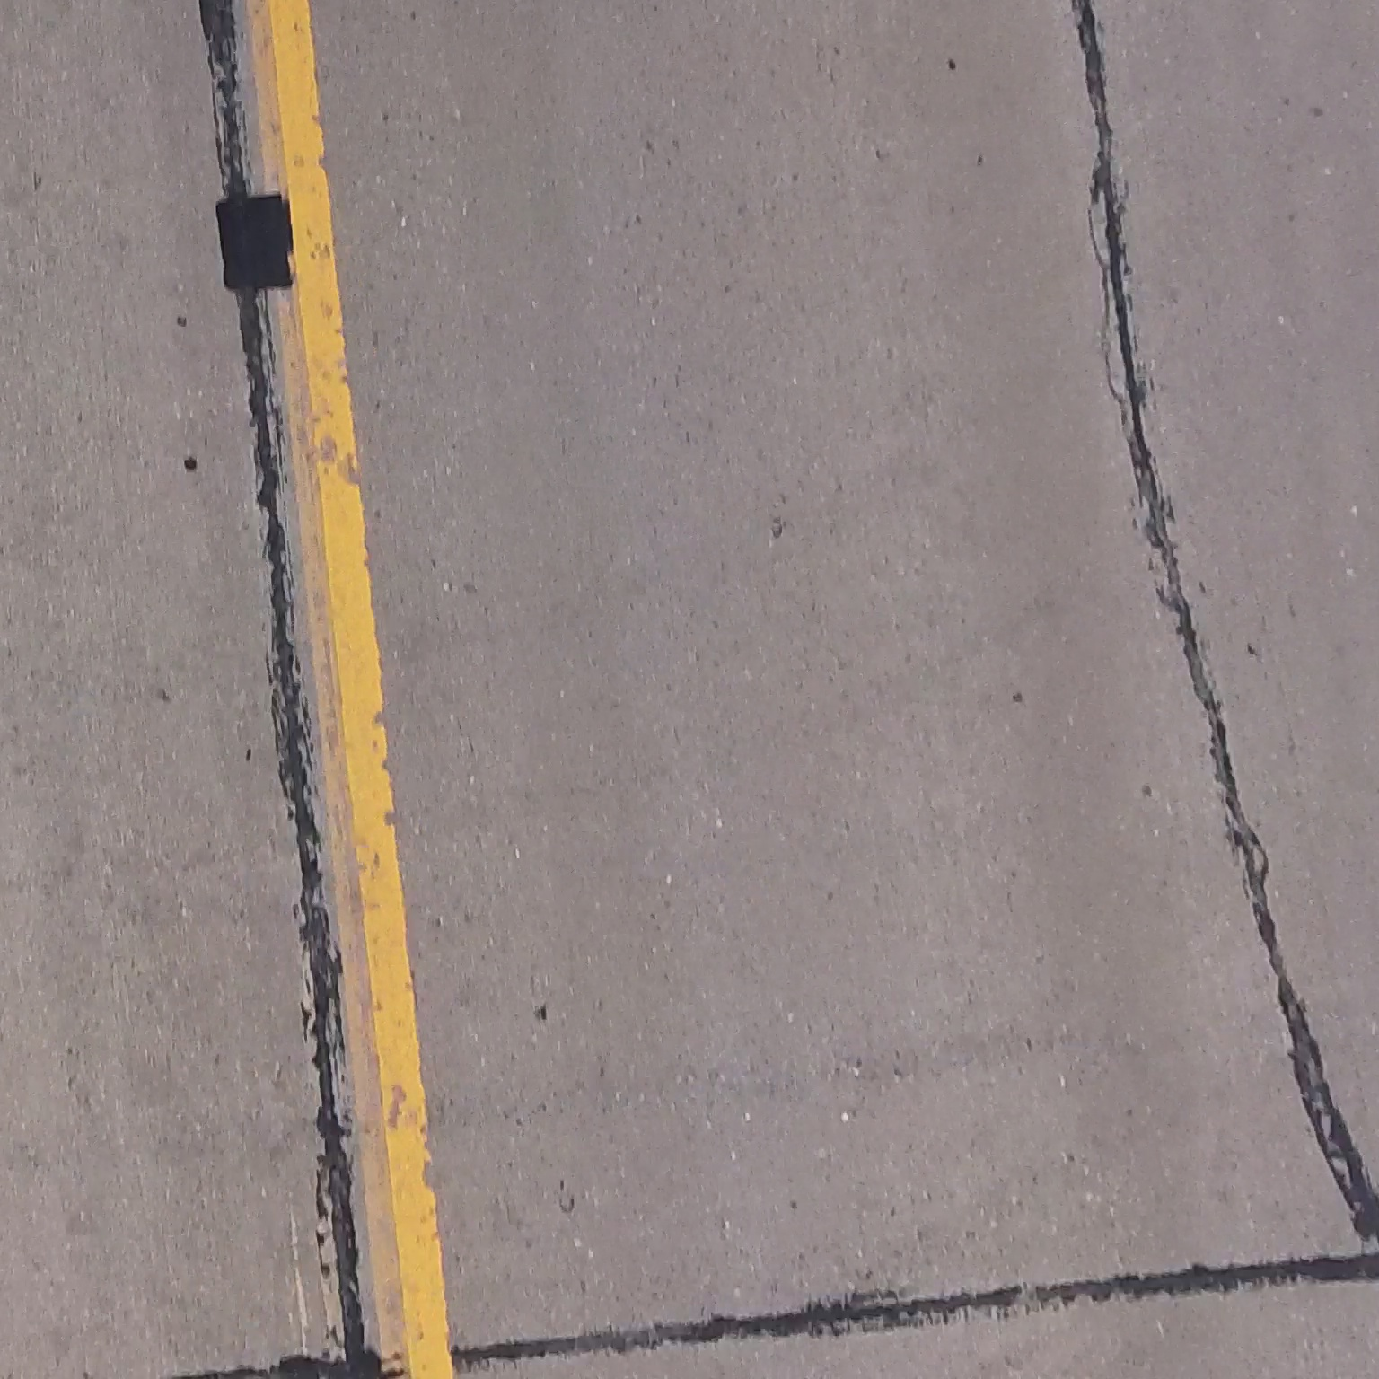
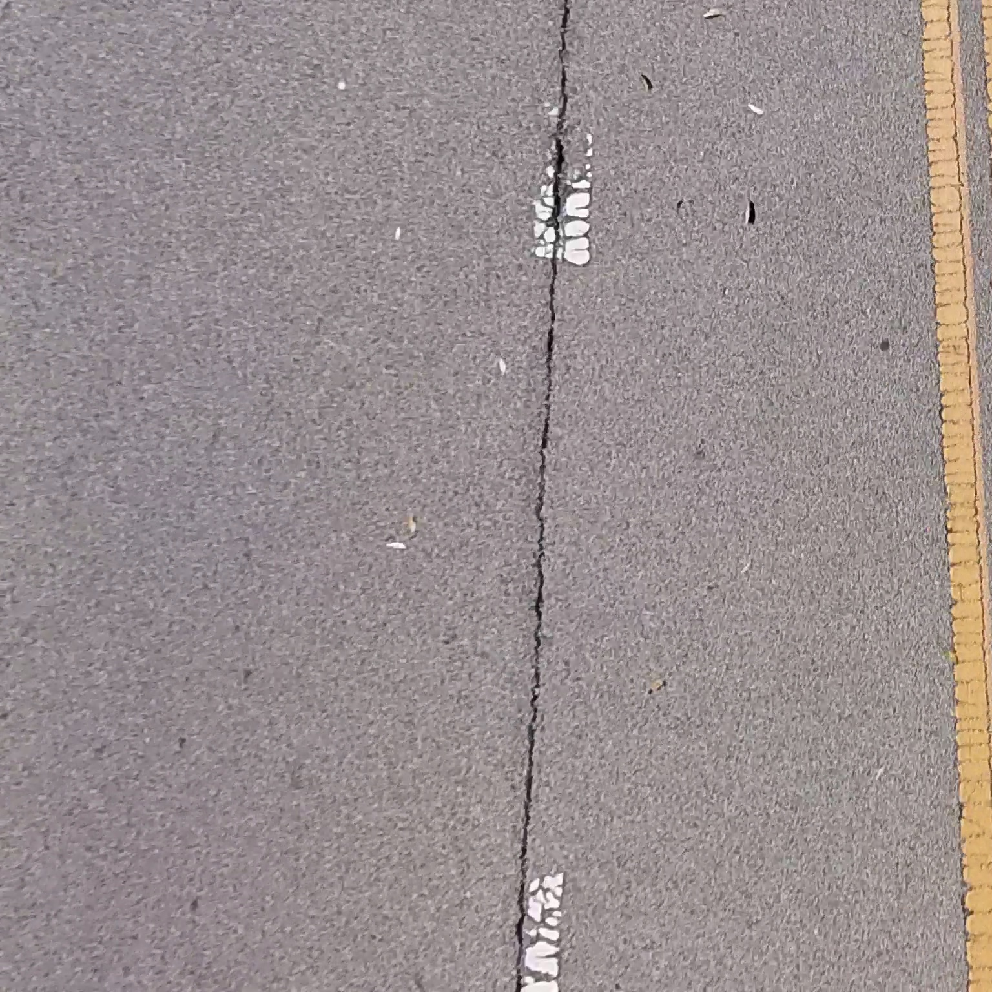
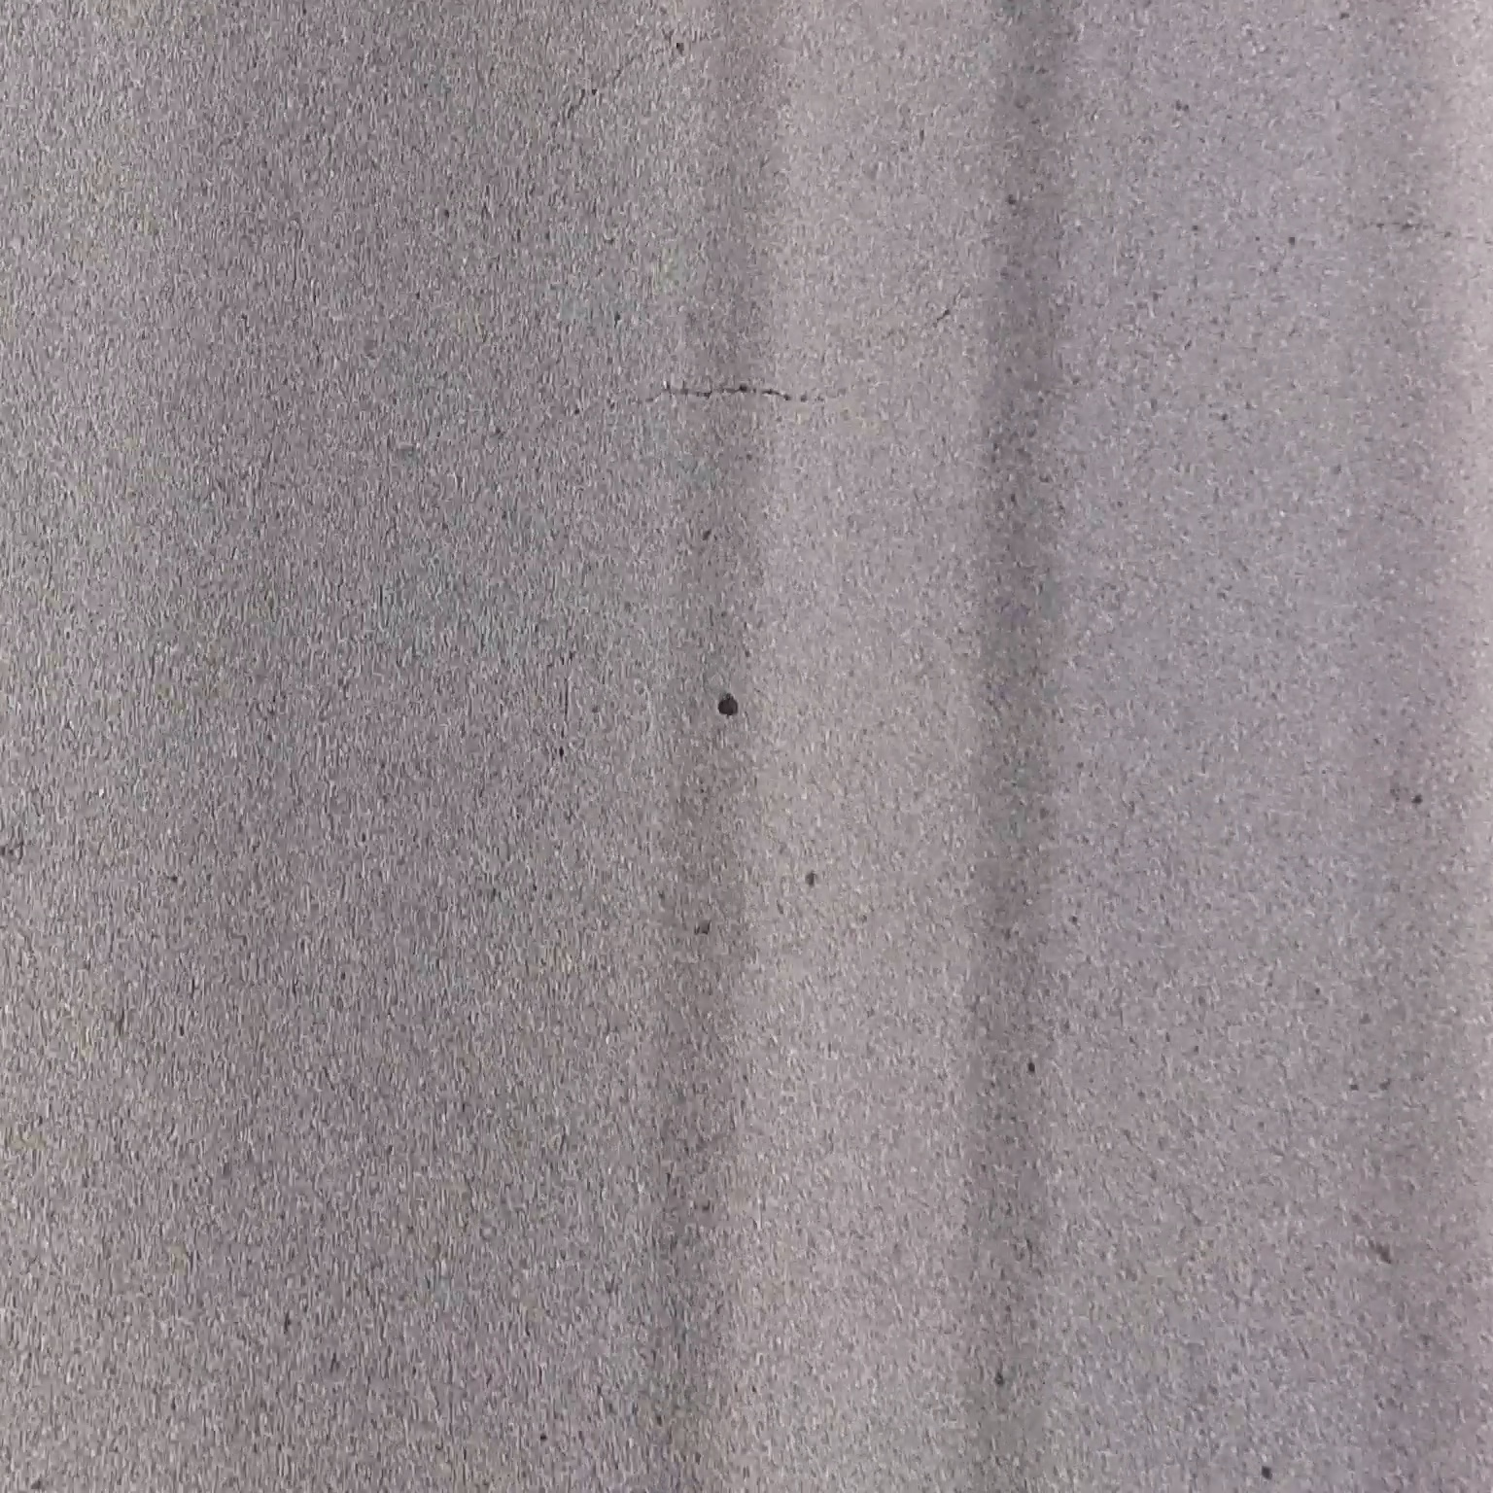
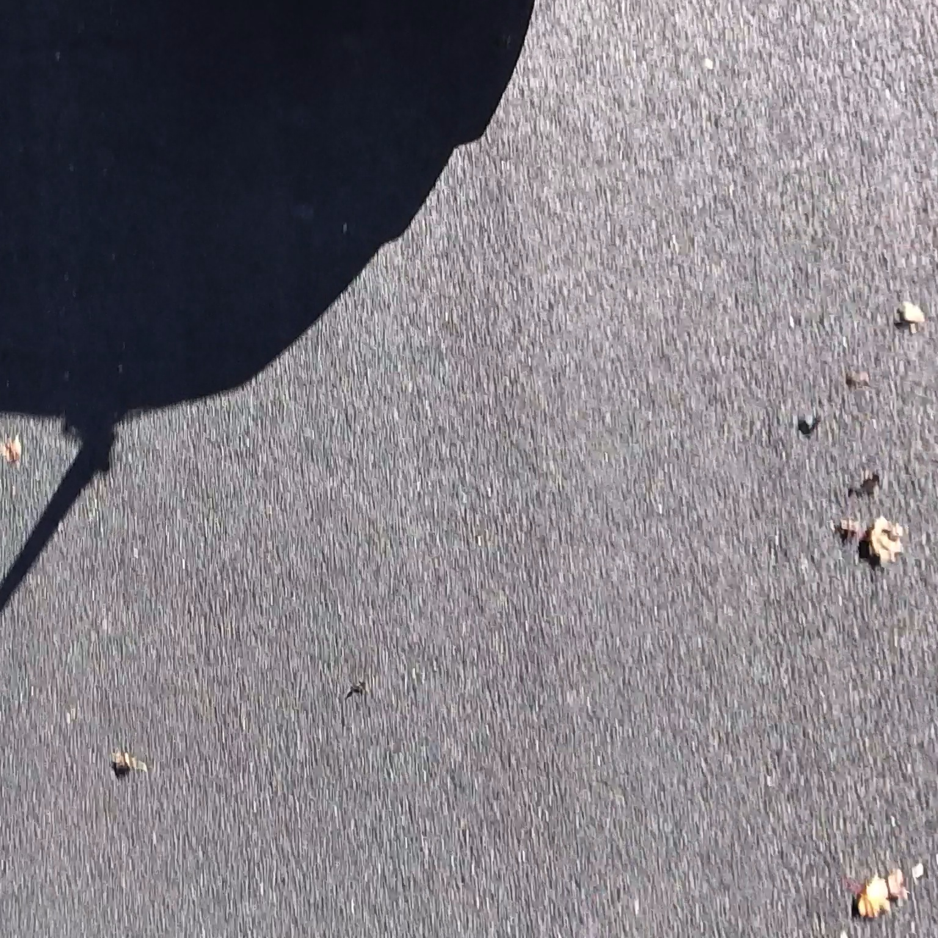
PCI=4
PCI=16
PCI=42
PCI=62
PCI=91
PCI=100

Slide 12
